Slide 1
Hard Drive Fault Prediction
Members:
Abu Mathew Thoppan A0178303H (e0267614@u.nus.edu)
Balagopal Unnikrishnan A0178398E (e0267709@u.nus.edu)
Gopalakrishnan Saisubramaniam A0178249N (e0267560@u.nus.edu)
Nivedita Valluru Lakshmi A0178253Y (e0267564@u.nus.edu)
Yesupatham Kenneth Rithvik A0178448M (e0267759@u.nus.edu)

Slide 2
Description
Backblaze takes a snapshot of each operational hard drive that includes basic hard drive information (e.g., capacity, failure) and S.M.A.R.T. statistics reported by each drive.
Data spanning four quarters in 2018 and contains basic hard drive information and 50 different S.M.A.R.T. statistics.
Each row represents a daily snapshot of one hard drive.
Blackblaze dataset: https://www.backblaze.com/b2/hard-drive-test-data.html
Kaggle link: https://www.kaggle.com/backblaze/hard-drive-test-data/home

Slide 3
Why S.M.A.R.T. Metrics?
SMART monitors the performance of a hard drive in real time. Analysis of collected data and evaluation of each characteristic in two groups takes place inside the system every second:
Signs of storage device normal wearing (the number of cycles, heads movements, spindle hub rotations) device current status (the number of errors and the time of searching for a track, the elevation of heads above the drive, the total number of active sectors)
Performance assessments typically are in the range from 0 to 100. The higher is the number, the better is the performance of a data storage device in this particular characteristic. A low number indicates a high probability of future failure. https://howtorecover.me/best-programs-read-smart-attributes-hdd
If the S.M.A.R.T. status indicates that you have an error, it does not necessarily mean that your hard drive is going to fail immediately. However, if there’s a S.M.A.R.T. error, it would be wise to assume that your hard drive is in the process of failing. A complete failure could come in a few minutes, a few months, or—in some cases—even a few years. https://www.howtogeek.com/134735/how-to-see-if-your-hard-drive-is-dying/

Slide 4
Metadata
date: Date in yyyy-mm-dd format
serial_number: Manufacturer-assigned serial number of the drive
model: Manufacturer-assigned model number of the drive
capacity_bytes: Drive capacity in bytes
failure: Contains a “0” if the drive is OK. Contains a “1” if this is the last day the drive was operational before failing
variables that begin with 'smart': Raw and Normalized values for 50 different SMART stats as reported by the given drive
The chosen objective is to classify whether a hard drive will fail or not

Slide 5
Dataset Pre-processing
9,992,362 unique rows from 32,164 unique hard drives (2018 Q1,Q2,Q3,Q4)
After removing columns and rows with NA (thresh=999999), we end up with (9992205, 21) features and 1 target
For phase -1 we remove duplicates and retain one record per serial number
Per Class distribution:
0 class – 31583
1 class – 581
Split train and test – 50-50 with stratified sampling (16082 samples per file)
Apply Z-score (Standard scaling) to fit the training set and transform the test set

Slide 6
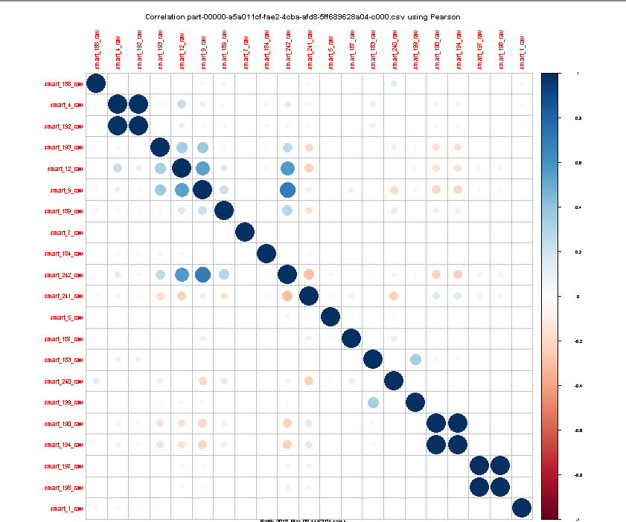
Data Understanding – Correlation Analysis
SMART 4 and 192 exhibit high correlation as they relate to the number of cycles on start after shutdown. 192 captures power off cycles and is complemented by 4 which increments the value on startup.
SMART 190 and 194 deal with temperature, hence highly correlated.
SMART 197 and 198 exhibit high correlation because 197 defines unstable sectors due to read errors and 198 gives count of uncorrectable errors while read/write to a sector.
SMART 9,12 and 242 are correlated to an extent as they cover related features - number of hours the drive is up, count of full power on/off cycles, and the Logical Block Addresses read during the time it was up.

Slide 7
Data Understanding – based on Wikipedia
SMART ID | Attribute Name | Description | Comments
5 | Count of re-allocated sectors | The raw value of the no. of bad sectors that were found and remapped. | This metric has been used to indicate the life expectancy of the drive.
7 | Seek Error Rate | The raw value gives the drive’s magnetic head seek error rate. | Different value measurements reported by different vendors. For the same vendor and model, the values should be consistent.
183 | Runtime Bad Block | The total no. of data blocks with detected and un-correctable errors occurred during regular operations. | An indicator of drive aging and/or potential electromechanical problems
184 | End-to-End error / IOEDC | Contains the parity error count that exists in the data path to the media through the drive’s cache RAM. | Ideal value should be low as parity errors occur when data gets corrupted during transmission.
187 | Un-correctable errors | No. of errors that could not be corrected using hardware ECC | High error count is a sign of failing drive.
188 | Aborted operations | The no. of operations aborted due to hard disk drive timeout. | This value is close to 0 for healthy drives.
197 | Pending sector count | The no. of unstable sectors that are to be remapped due to un-recoverable read errors. | The sector is remapped and this value is decreased over time on subsequent successful reads.
198 | Count of un-correctable errors | The total count of uncorrectable errors when reading/writing a sector. | A rise in the value of this attribute indicates defects of the disk surface and/or problems in the mechanical subsystem.

Slide 8
Phase 1
Treating each serial number as unique record without consideration of time (date)

Slide 9
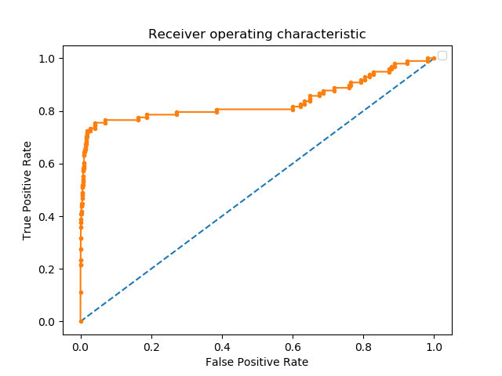
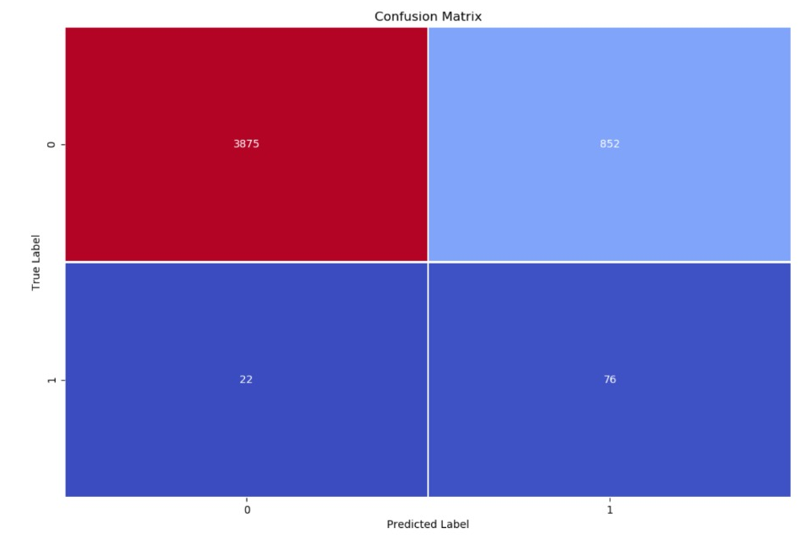
ROC - All Features
Chosen classifier: SVM
AUROC: 0. 836
Selected threshold: 0.013339 FPR:0.187856991749524 TPR: 0.7755102040816326
precision recall f1-score support 0 0.99 0.79 0.88 4727 1 0.07 0.79 0.13 98
micro avg 0.79 0.79 0.79 4825 macro avg 0.53 0.79 0.51 4825 weighted avg 0.98 0.79 0.87 4825

Slide 10
Feature Selection Strategies
Variance threshold - Feature selector that removes all low-variance features.
Unsupervised technique
Threshold: 0.025
Removed features: None
RFE - Feature ranking with recursive feature elimination.
Estimator: Logistic Regression (default 100 iterations)
# features to select: 15
# features to discard per iteration: 1
Criterion: Weight coefficients
Removed features: 6
Sequential Forward Selection (SFS) - SFS is a greedy search technique which returns a subset of features; the number of selected features k, where k<d, has to be specified a priori.
# features to select: 15
Criterion: AUROC (each step will add a feature ki that that maximizes the AUROC at that step)
Removed features: 13
Sequential Backward Selection (SBS) - Similar to SFS described above
Removed features: 6
Forward

Slide 11
Choosing Feature Selector
Results on svm with rbf kernel on all 4 feature selectors:
rfe
[[7884 1]
[ 137 19]]
precision recall f1-score support
0 0.98 1.00 0.99 7885
1 0.95 0.12 0.22 156
micro avg 0.98 0.98 0.98 8041
macro avg 0.97 0.56 0.60 8041
weighted avg 0.98 0.98 0.98 8041
seq_fwd
[[7883 2]
[ 143 13]]
precision recall f1-score support
0 0.98 1.00 0.99 7885
1 0.87 0.08 0.15 156
micro avg 0.98 0.98 0.98 8041
macro avg 0.92 0.54 0.57 8041
weighted avg 0.98 0.98 0.97 8041
forward
[[7883 2]
[ 122 34]]
precision recall f1-score support
0 0.98 1.00 0.99 7885
1 0.94 0.22 0.35 156
micro avg 0.98 0.98 0.98 8041
macro avg 0.96 0.61 0.67 8041
weighted avg 0.98 0.98 0.98 8041
seq_bwd
[[7884 1]
[ 142 14]]
precision recall f1-score support
0 0.98 1.00 0.99 7885
1 0.93 0.09 0.16 156
micro avg 0.98 0.98 0.98 8041
macro avg 0.96 0.54 0.58 8041
weighted avg 0.98 0.98 0.97 8041

Slide 12
Handling Class Imbalance
SMOTE
Minority class upsampled (1:0.6 for 0 to 1 classes)
(array([0, 1], dtype=int64), array([15792, 9475], dtype=int64))
New sample distribution:
Class 0 – 15792
Class 1 – 9475

Slide 13
Model Training
Logistic Regression
Decision Tree
Random Forest
Support Vector Machine
The best parameters for each model is selected using Grid Search and using k-fold cv (k=7)

Slide 14
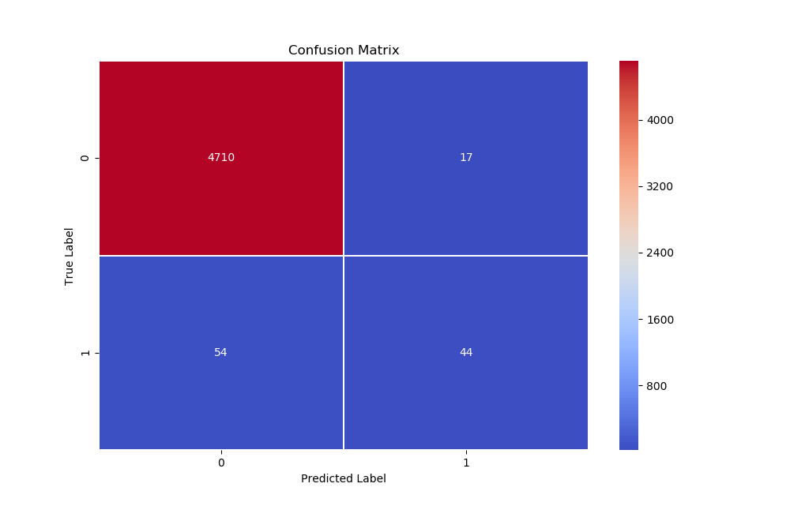
Decision Tree Classifier
Grid Search tuning_parameters = {'min_samples_split': range(10, 500, 10),
'max_depth': range(1, 20, 2),
'max_features':range(1,X_train.shape[1])}
Best score for data: 0.9880074620236298
Best value for min samples to split: 10
Best max depth value: 7
Best value to decide how many features to consider for splitting: 7
precision recall f1-score support
0 0.99 1.00 0.99 4727
1 0.81 0.30 0.43 98
micro avg 0.98 0.98 0.98 4825
macro avg 0.90 0.65 0.71 4825
weighted avg 0.98 0.98 0.98 4825

Slide 15
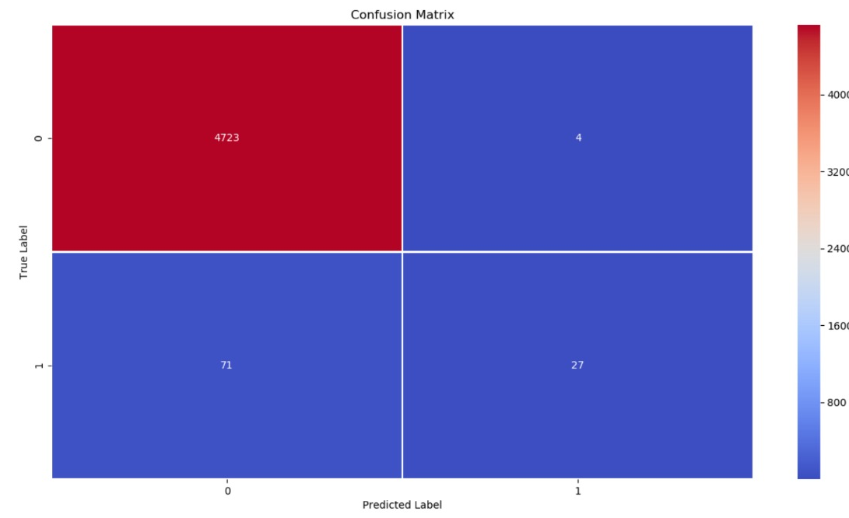
Support Vector Machine
Grid Search tuned_parameters = [{'kernel': ['rbf'], 'gamma': [1e-3, 1e-4], 'C': [1, 10, 100, 1000]},
{'kernel': ['linear'], 'C': [1, 10, 100, 1000]}]
best score for data1: 0.9880074620236298
Best C: 10
Best Kernel: linear
Best Gamma: auto_deprecated
precision recall f1-score support
0 0.99 1.00 0.99 4727
1 0.87 0.28 0.42 98
micro avg 0.98 0.98 0.98 4825
macro avg 0.93 0.64 0.71 4825
weighted avg 0.98 0.98 0.98 4825

Slide 16
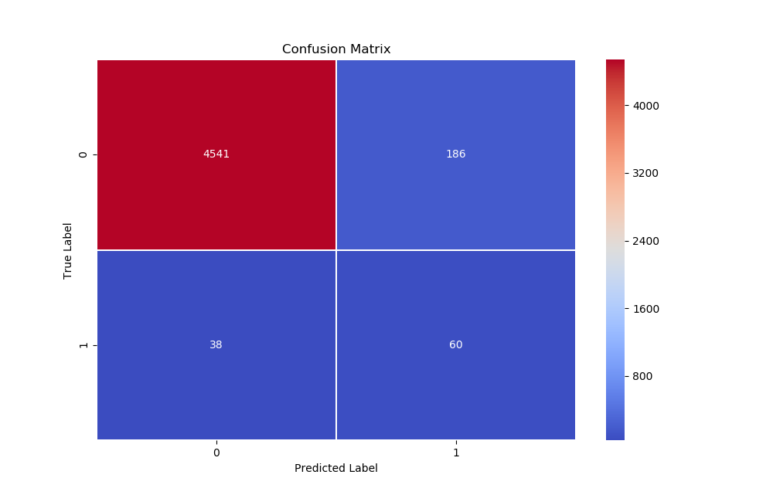
Logistic Regression
Grid Search tuning_parameters = {'penalty': ["l2"],
'class_weight': ['balanced'],
'random_state': [42],
'tol': [1e-3, 1e-4],
'solver': ['newton-cg', 'lbfgs', 'liblinear', 'sag', 'saga’],
'C': [0.1, 0.5, 1, 2, 10, 100, 1000]}
Best score for data: 0.9563826952118681
Best tolerance value: 0.001
Best solver: newton-cg
Best value for C 0.5
precision recall f1-score support
0 0.99 0.96 0.98 4727
1 0.24 0.61 0.35 98
micro avg 0.95 0.95 0.95 4825
macro avg 0.62 0.79 0.66 4825
weighted avg 0.98 0.95 0.96 4825

Slide 17

Random Forest
Grid Search tuning_parameters = {'criterion':['gini','entropy'],
'n_estimators': range(10, 20, 5),
'min_samples_split': range(10, 100, 10),
'max_depth': range(4, 10, 2)}
Best score for data: 0.9888957981700275
Best no. of estimators: 10
Best criterion for splitting: entropy
Best value for min samples to split: 30
Best max depth value: 8
precision recall f1-score support
0 0.99 1.00 0.99 4727
1 0.91 0.41 0.56 98
micro avg 0.99 0.99 0.99 4825
macro avg 0.95 0.70 0.78 4825
weighted avg 0.99 0.99 0.98 4825

Slide 18
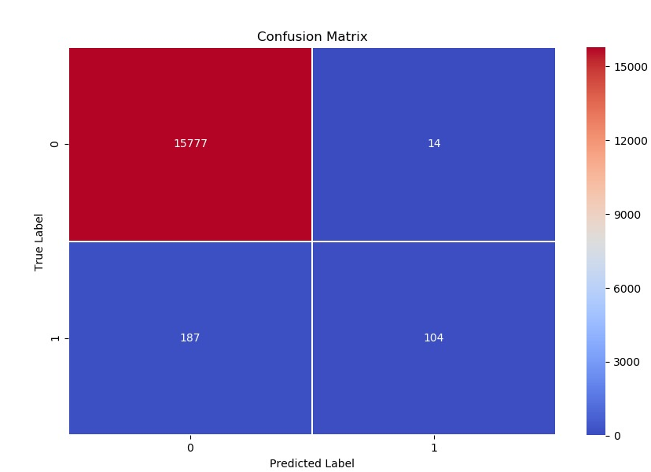
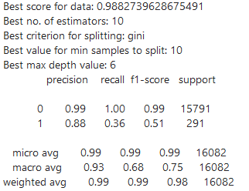
Test Set
Best among models: Random Forest

Slide 19
Extras

Slide 20
Evolving S.M.A.R.T. Metrics
2015-2017 SMART Stats – 90 columns of data, that are the Raw and Normalized values for 45 different SMART stats as reported by the given drive. Each value is the number reported by the drive.
2018 (Q1) SMART Stats – 100 columns of data, that are the Raw and Normalized values for 50 different SMART stats as reported by the given drive. Each value is the number reported by the drive.
2018 (Q2) SMART Stats – 104 columns of data, that are the Raw and Normalized values for 52 different SMART stats as reported by the given drive. Each value is the number reported by the drive.
2018 (Q4) SMART Stats – 124 columns of data, that are the Raw and Normalized values for 62 different SMART stats as reported by the given drive. Each value is the number reported by the drive.
https://en.wikipedia.org/wiki/S.M.A.R.T. S.M.A.R.T. (Self-Monitoring, Analysis and Reporting Technology; often written as SMART) is a monitoring system included in computer hard disk drives (HDDs), solid-state drives (SSDs) and eMMC drives. Its primary function is to detect and report various indicators of drive reliability with the intent of anticipating imminent hardware failures.

Slide 21
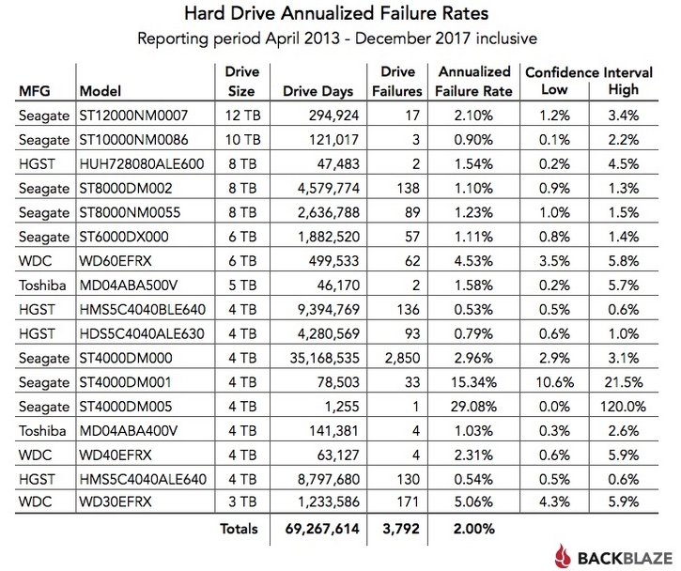
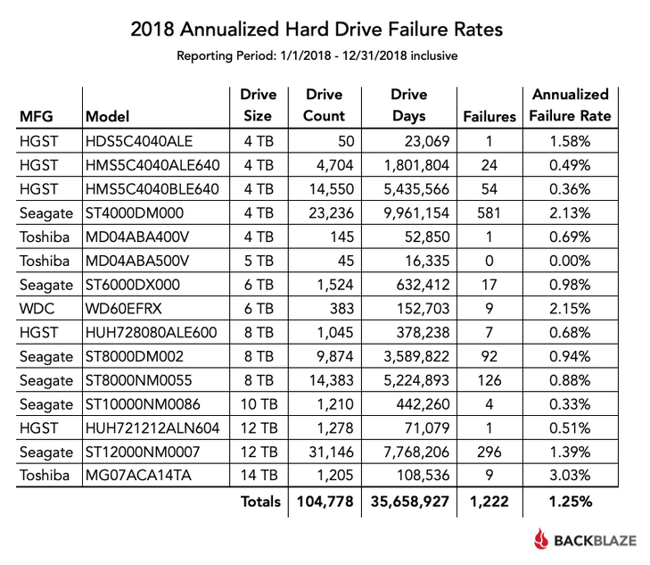
Selection of HDD Brand
2013 - 2017 only
2018 only

